Slide 1
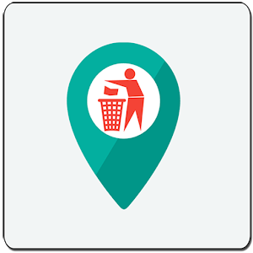
Garbageo
Your Garbage Collector
DSC KIIT #DEVHACK

Slide 2
Hello!
I, Saswata, on behalf my fellow team members welcome you to look into our Garbageo App. We have provided some awesome and up-to-date features and we hope you may like it.

Slide 3
Problem Statement and Solution
1

Slide 4
Problem Statement
To manage different types of wastes efficiently and create a smart waste collection system that allows citizens to segregate various types of wastees they want to dispose and the municipal authorities to efficiently collect the same.

Slide 5
Solution
Our system basically contains three major parts:
Smart Dustbin
App for Users
App for Garbage Truck Drivers

Slide 6
Solution
Basic Motive?
To create an app for users and municipal authority(or garbage collectors) . There are also IOT based Smart Dustbins that contains IR sensors which records how many items are thrown into the Dustin with a datetime stamp and uploads the data to a database.

Slide 7
The Process Involved in the System
2

Slide 8
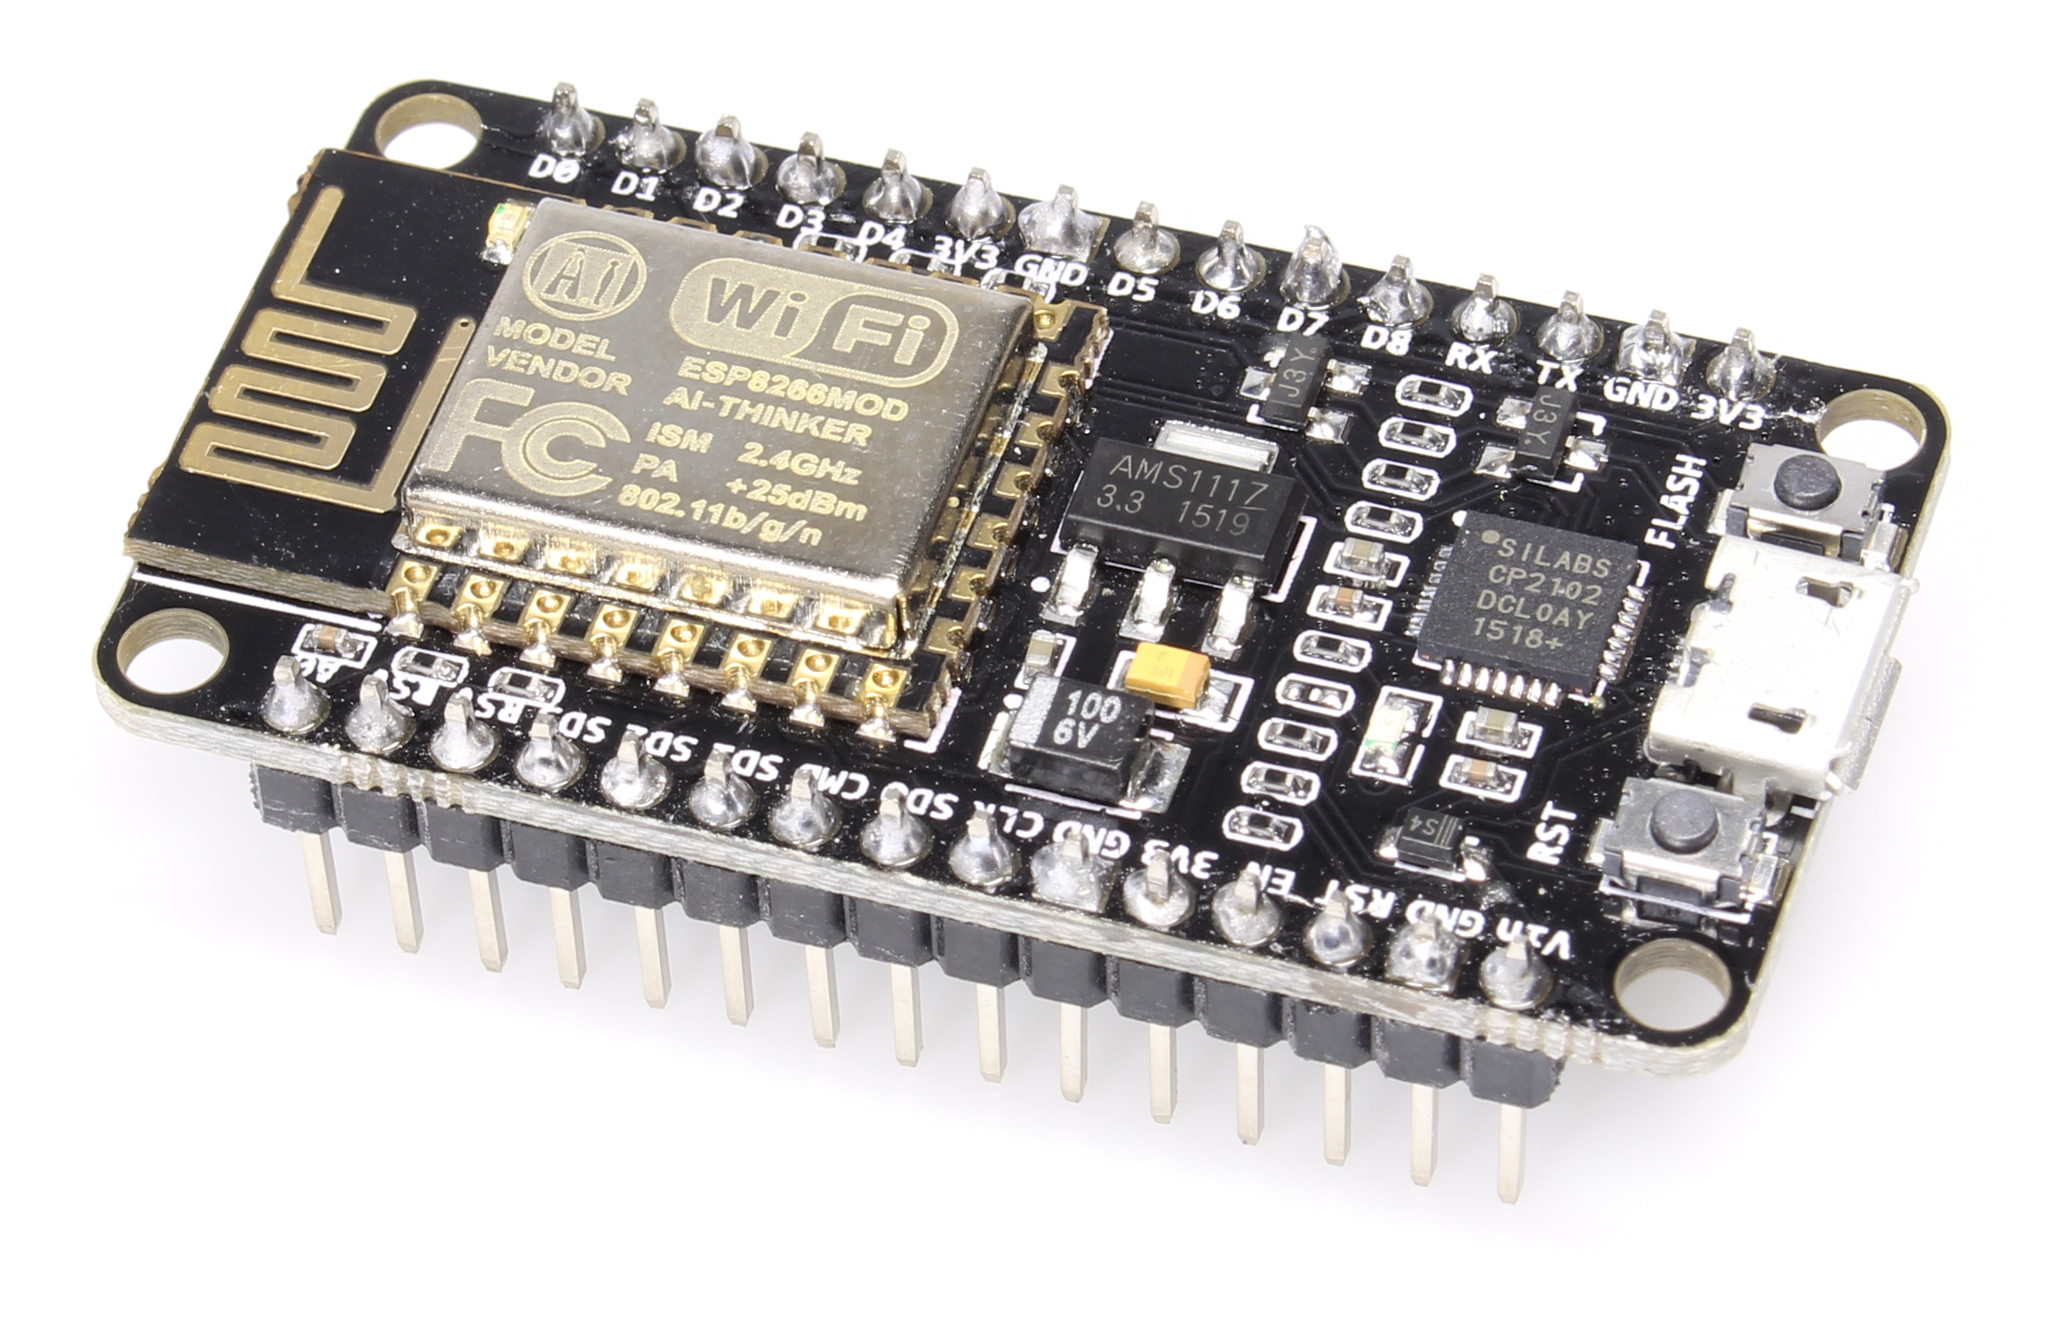
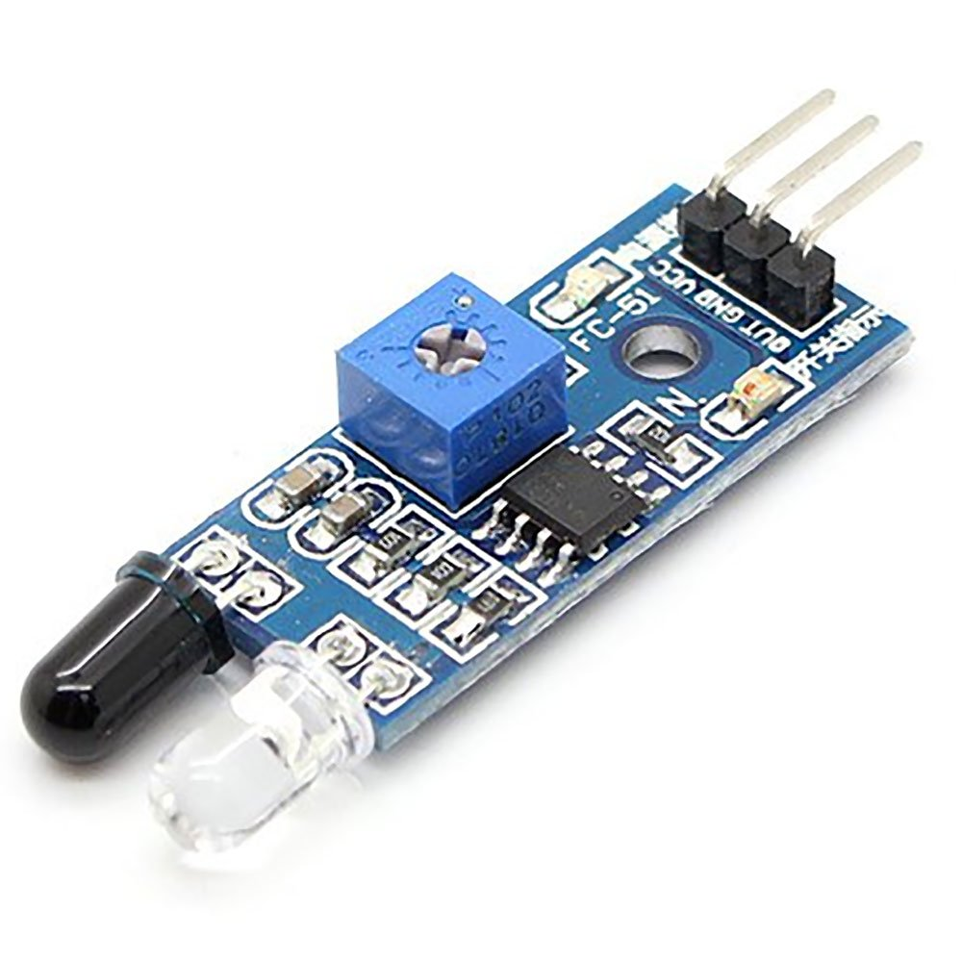
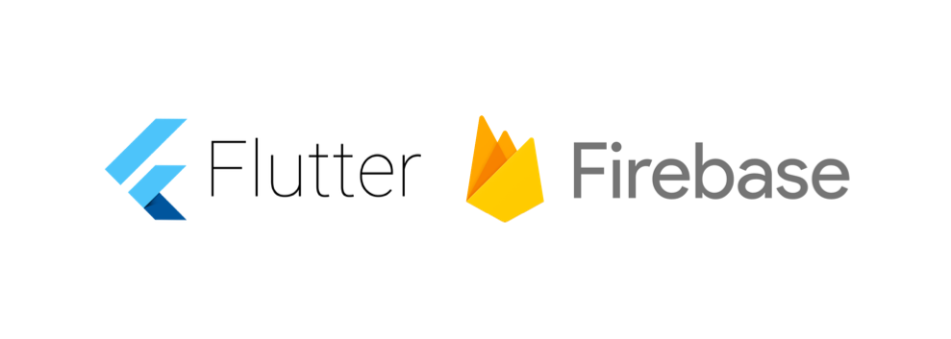

Technologies Used ?
This App uses flutter which is an awesome app development platform which also provides beautiful , latest and fastest technologies to the user.
The Smart Dustbin uses IR Proximity Sensors connected to NodeMCU ESP8266 Wifi Module MicroController
For the programming part it uses Flutter along with Google Firebase Database and MapBox API for maps

Slide 9
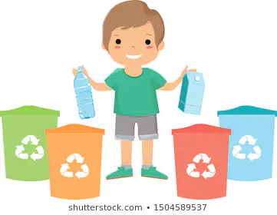
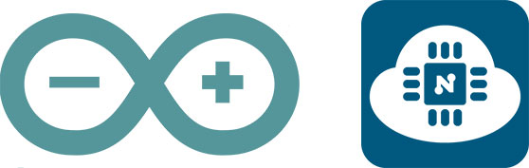

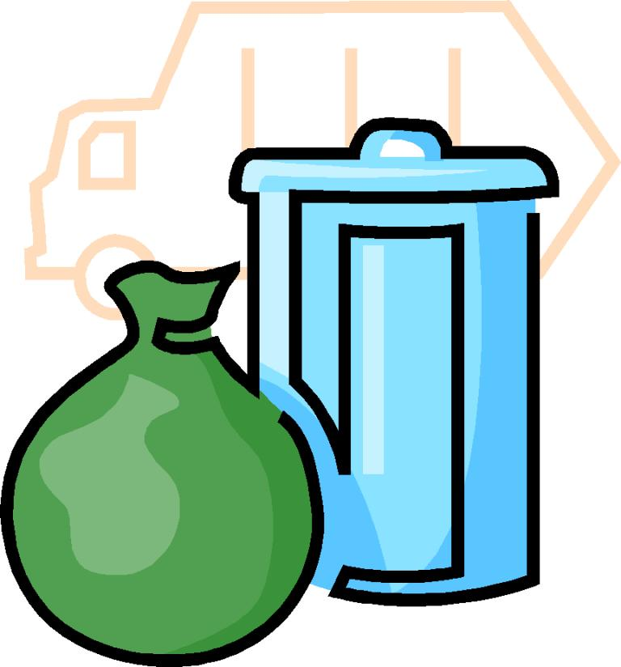
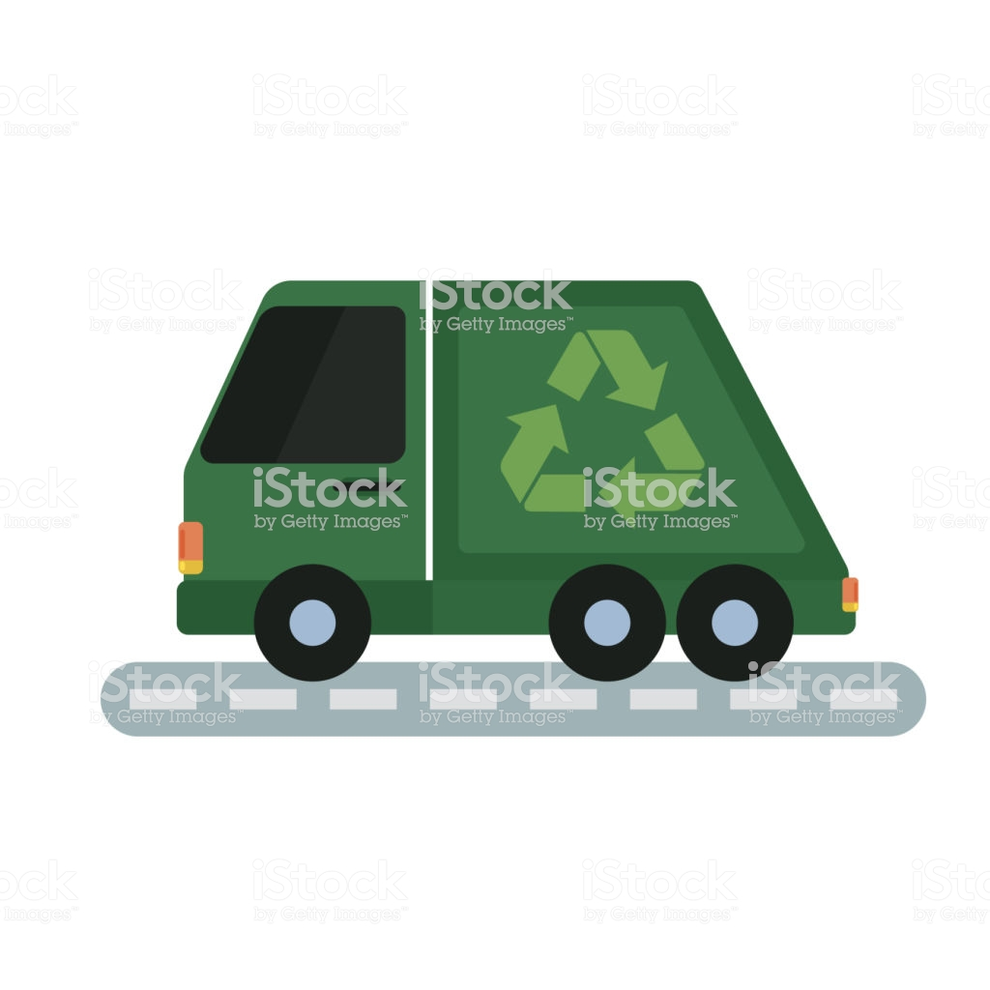
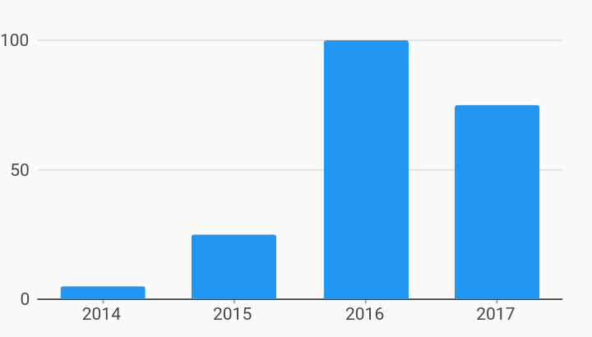
Process Involved...
User throws garbage into respective dustbin
The IR sensor records the number of garbages thrown through motion-detector mechanism
The readings of the IR sensor through NodeMCU are stored in the Firebase Database
The truck drivers can navigate to the user using the user location, pickup the garbage and dump it or recycle it respectively
The User can request for a garbage pickup. The requests aer stored in the Firebase database which contains the user location.These pickup requests can be retrieved by the garbage collectors
The User is shown the data of how much and of what kind of garbage he/she produces through charts by retrieving the data from Firebase

Slide 10

Why Flutter ?
Flutter is a free and open source Google mobile UI framework that provides a fast and expressive way for developers to build native apps on both IOS and Android.
Flutter is focusing on a single codebase (i.e. Dart). This single code base is going to produce by IOS and Android app. Therefore, this codebase not using for javascript, Swift, C++, etc.
Flutter moves to a widget, rendering, animation and gestures into this framework to give you to complete control over every pixel on the screen. It means you have the flexibility to build a custom design.
Flutter apps follow platform conventions and interface details such as scrolling, navigation, icons, fonts, etc. That why apps built with Flutter features on both of the APPSTORE and GOOGLE PLAY STORE.
AnimationBuilder, FutureBuilder, StreamBuilder,…Once you understand them you have no limit. Anything is a widget. A button can use as a screen, a full page used as a button with animation and transformation.

Slide 11
Advantages ?
3

Slide 12
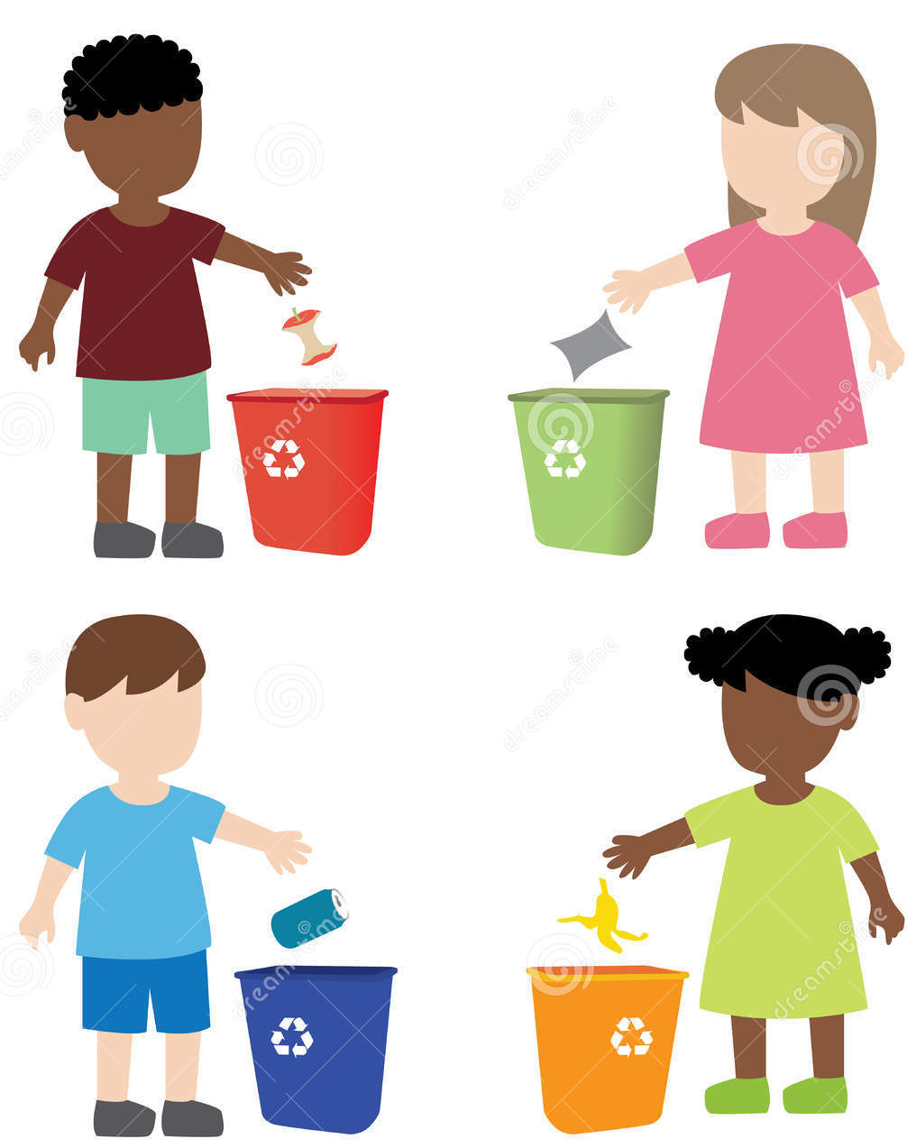
Benefits for Users
The App keeps track of all types of wastes that are disposed by the user in an interactive manner which uses graphs and charts.
The App provides a garbage pickup feature which creates a request on the server forwarded to a garbage collector of municipal corporation and who will collect the garbage from the user.
App also provides real money in the user wallet for each organic waste disposed by user. Money can be withdrawn in bank account anytime once it reaches a threshold value.

Slide 13
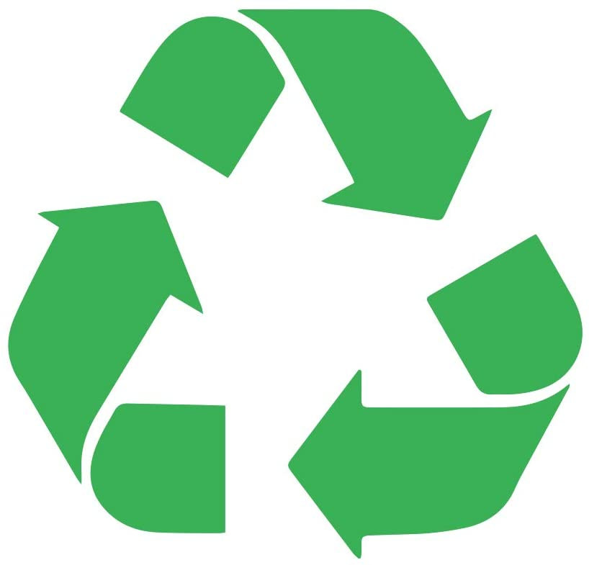
Environmental Effects
This solution effects environment positively as all different types of wastes are disposed seperately and effectively. In many places, all wastes are kept on the roadside in a bunch which harms the environment and also contaminates useful wastes.
Organic waste that can be recycled are collected by the municipal corporation and used for creating manure which will benefits the farmers and crops.
All the Toxic wastes are handled separately and disposed carefully by muncipality so that it does not contaminates environment and other organic waste.

Slide 14
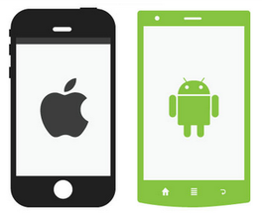
Ease that we provide
Now-a-days almost every hands hold smartphones. And everyone knows how and when to use it. Thats why, we created an user friendly App with better UI for the user. It can be easily downloaded from Play store and Apple Store for Android and iOS smartphones respectively.
Our App doesnt require latest smartphones or heavy a processor or RAM . It can easily be used smoothly on outdated smartphones even with a 2G connection to make sure that this app reaches every smartphone using citizen and Municipality workers.
This app can be made in collabration with the government to provide more realistic features.

Slide 15
Business Model
3

Slide 16

Total Addressable Market
Waste Management provides solid waste collection, transfer, disposal and recycling services for the residential, commercial and municipal sectors.
Placing an example : People who are disposing the organic waste will be paid . From their we will be getting the commision. This will create more interest in the mass for disposing the wastes correctly coz 'MONEY TALKS'.
Our app will be linked to Government , from where we will be get funding.
The Government can raise the fund from manure production with those organic wastes.

Slide 17
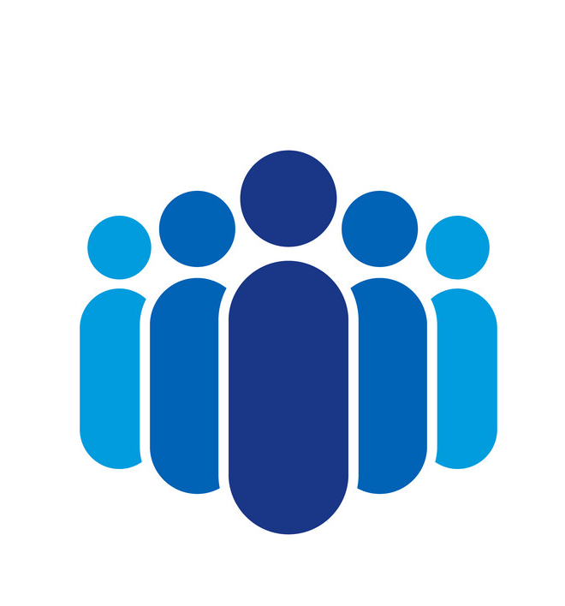
Target Audience
Waste management is essential for controlling different types of pollution such as water, air, soil etc. Food waste is biodegradable and can be used for production of compost. Additionally, waste generated from hospitals and other industries can be recycled. Therefore, proper management of waste is important. Waste management software is used by waste management organizations to plan waste storage, transportation, and disposal and to implement strategies for recycling of materials. The software is used to manage communication with customers(civilians) and contracts(municipal members) as well as billing and payments.

Slide 18
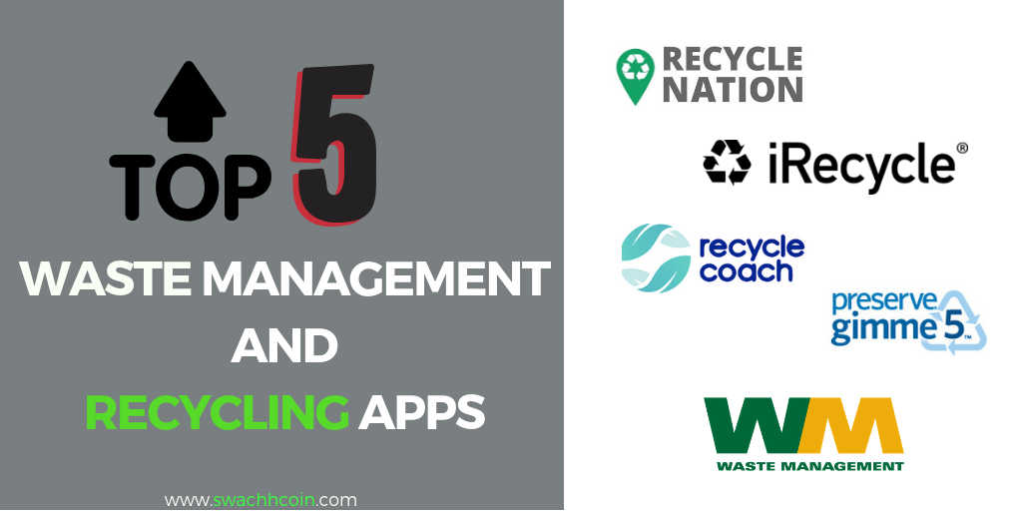
Competition
iRecycle app. The app helps users locate the nearest recycle centers in their vicinity.
Gimme 5 is an app that helps users identify the right recyclable plastics.
RecycleNation is a mobile app that helps improve that recycling rates in the US.
Our App helps us to record how many items are thrown into the Dustbin and proper disposal of the wastes.

Slide 19
Our Prototype
3

Slide 20
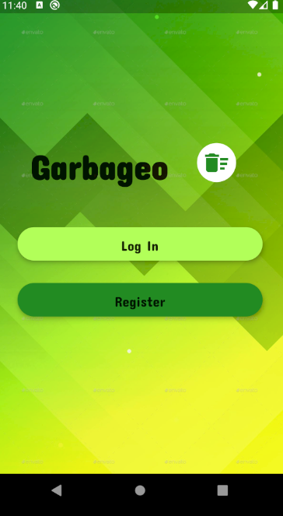
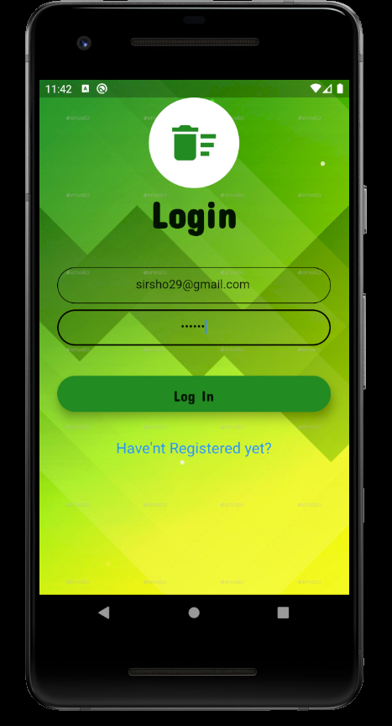

User Login and Registration

Slide 21
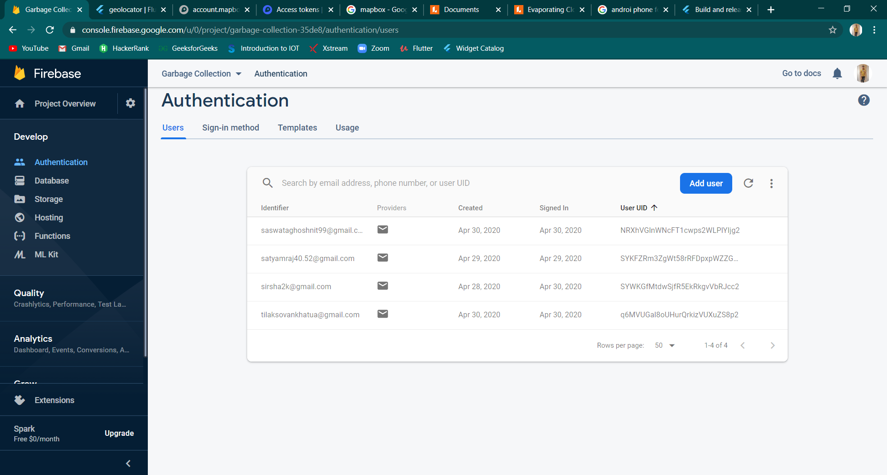
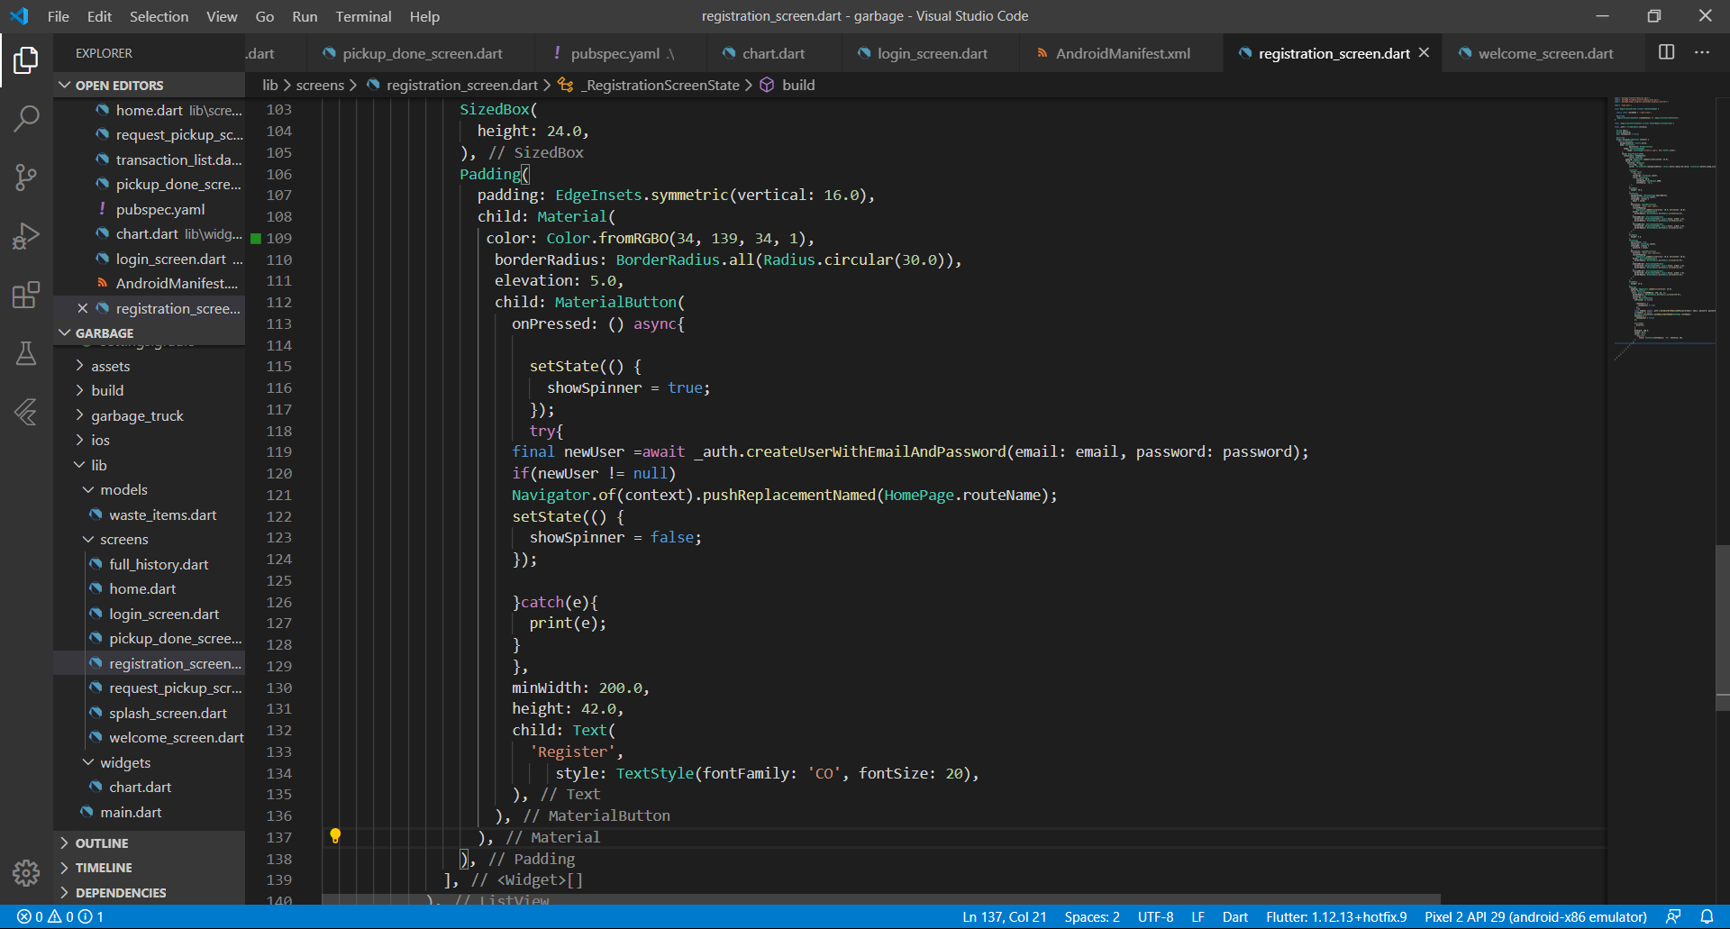
Managing new Users in Firebase
Code Snippet for registering new user to the Firebase

Slide 22
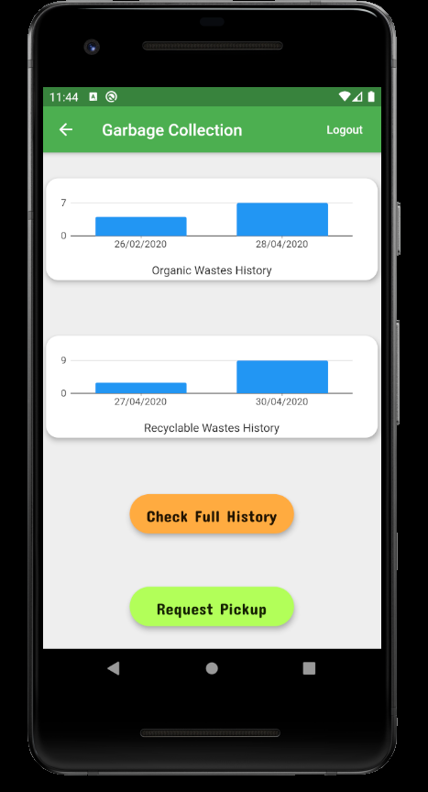
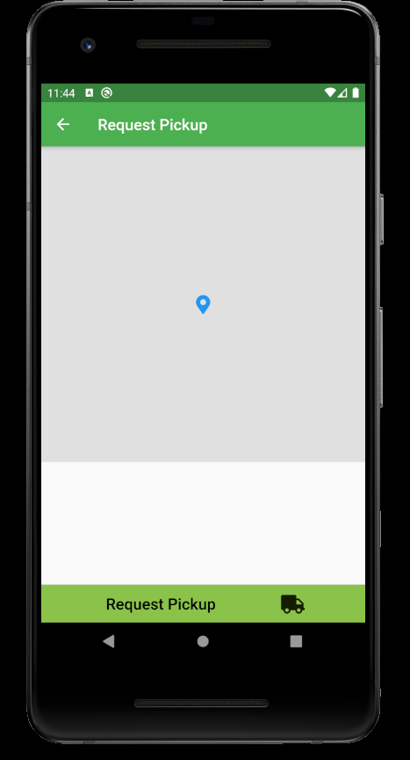
Home Screen and the Request Pickup Screen
The HomeScreen contains the Waste Production history for each kind of wastes.
(Currently the sensors and controllers are not available, so we have added the data manually)
The Map API is currently not working.(there is a problem with the map provider)For that reason map is not showing.
When user presses 'Request Pickup' button, his/her location and the date and time of request is stored in the firebase databse.

Slide 23
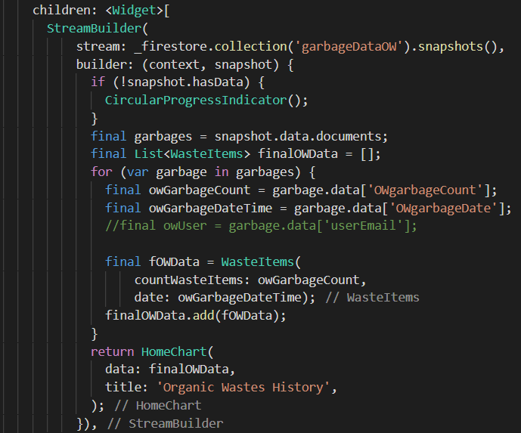
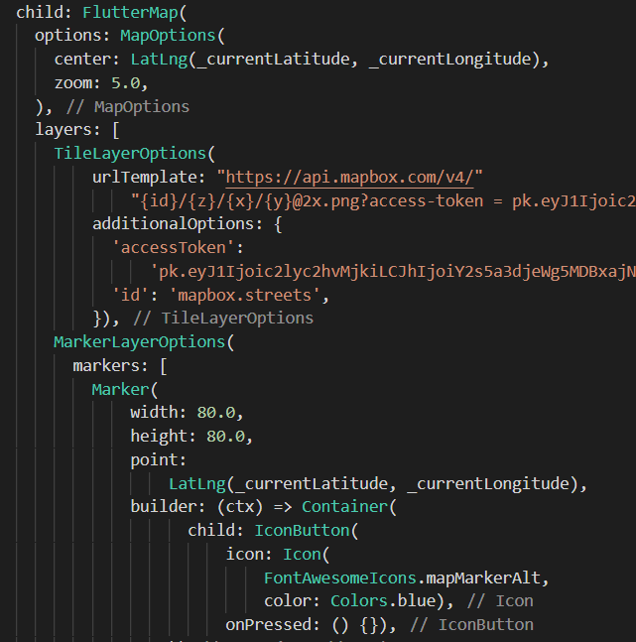
Few Code snippets...
Code Snippet for retrieving data from Firebase
Code Snippet for creating the map

Slide 24
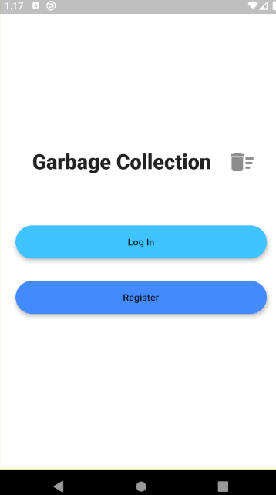
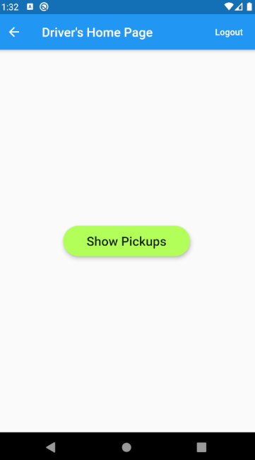
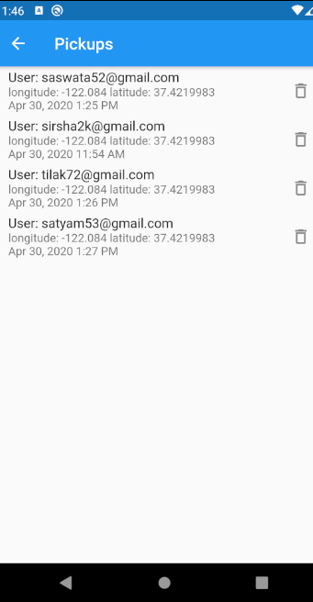
The Truck Driver's App
The Truck Driver also has login and registration functionalities...
The driver can see all the pickups by clicking on the 'see pickups; button
Details of all the pickups

Slide 25
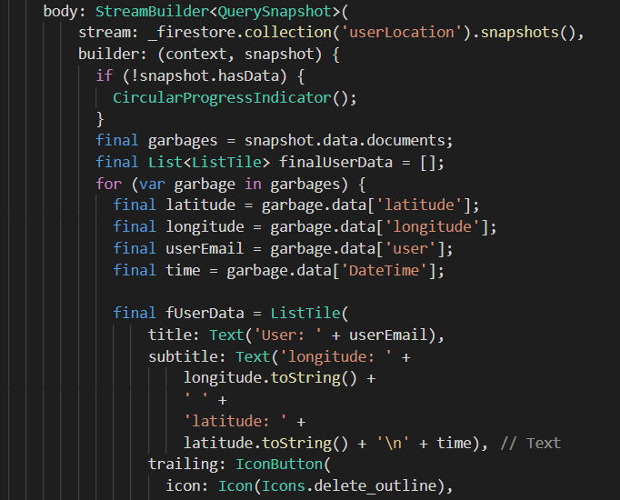
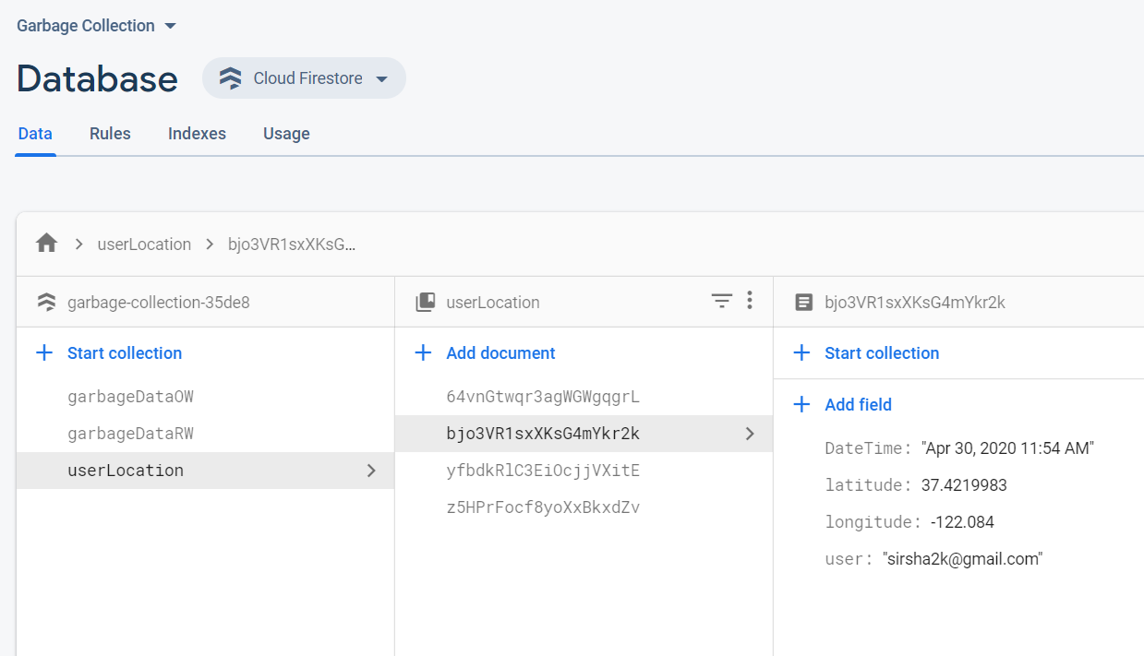
Pickup Locations' Database in Firebase
Code Snippet retrieving data from database

Slide 26

Further Plans with the Project...
First of all we will implement a fully functional Smart Dustbin that automatically reads the data as previously explained.
We will make our apps more user friendly.
We will add an automatic navigation feature which automatically shows the best possible route of garbage collection by the driver.
Also we will create a realtime database using firebase.

Slide 27
Forming Wastes is EASY
BUT
Disposing it is DIFFICULT

Slide 28
Thanks!

